Slide 1
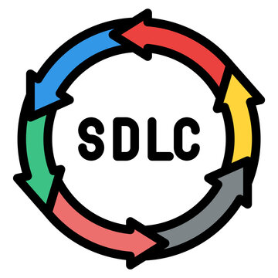
software development life cycle
Easiest explanation WITH EXAMPLES and diagrams

Slide 2


Software-
Before knowing about Software development life cycle(SDLC), you must know what is a software?
Software- A software is a set of instructions/program that is designed to perform a specific task.
Examples of software-
System software- Windows, Linux, MacOS ,
Application Software- MS Word, PowerPoint, Canva, notepad, mspaint, MP3player, VLC player.
Games, Web Browsers, Video editing and audio editing softwares.

Slide 3


Software development life cycle-
SDLC stands for Software Development Life Cycle. It is a process used by software industry professionals to design, develop, and test high-quality software.
It's a structured approach that helps create high-quality software efficiently.
By following the SDLC, software development becomes more manageable and predictable, ensuring that the final product is of high quality and meets user expectations.
Example/Analogy-
Think of creating software like building a house. You wouldn't start by just grabbing bricks and cement and randomly putting them together. Instead, you follow a structured plan to ensure the house is built correctly and meets your needs. SDLC is like that structured plan for software development.

Slide 4
SOME FAMOUS SDLC models are-
Different types of Software Development Life Cycle (SDLC) methodologies are needed because software projects vary widely in terms of complexity, size, requirements, and goals. Each SDLC model offers unique advantages and is suited to particular types of projects or organizational needs.
Classical Waterfall Model
Incremental Model
Agile model
Rapid Application Development (RAD) model
Spiral Model

Slide 5
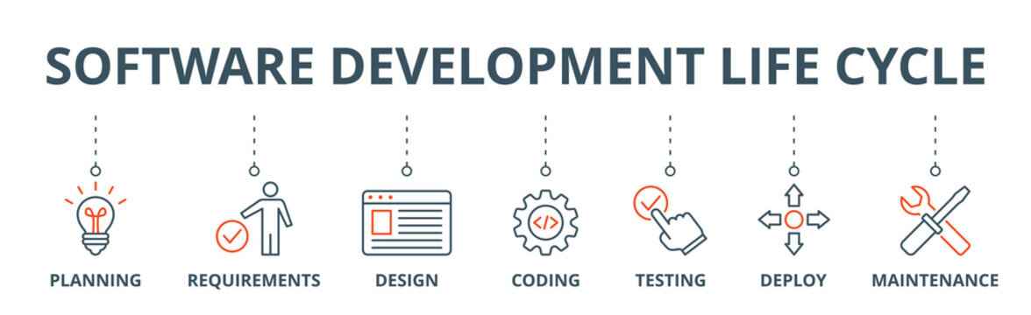
Phases/steps of sdlc-

Slide 6
PhASES/Steps of SDLC-
Planning and Requirement Gathering/Analysis- In this stage we take the inputs/requirements from the customer, defining the project scope, and creating a plan. Here we conduct a feasibility study (it is a decision point, it aims to identify potential challenges/risks associated with the project before significant resources are invested in development. By analyzing various aspects, the study helps stakeholders make informed decisions about whether to proceed with the project. Basically deciding that the project can be made or not).

Slide 7

PhASES/Steps of SDLC-
2. Defining the requirements- In this stage, the requirements that are specified by the customer/clients are clearly defined and documented in the SRS (Software Requirement Specification) document after getting them approved from the clients and market analyst.
3. Designing the product- In this stage, the system architecture is designed. Based on the requirements specified in the SRS document, usually more than one design approach for the product is proposed and then documented in a DDS- Design document specification.
Then the DDS is reviewed by all the important stakeholders and the best approach is selected for the product/software.

Slide 8
PHASES OF SDLC-
4. Building/Designing the product or Coding- The actual development starts in this phase. Programming Language is chosen with respect to the type of software being developed. This is where the coding happens. Developers write the code based on the design specifications. Individual component of the software are coded and then integrated together to build the full software.
5. Testing the product- To verify that the software functions correctly and meets the specified requirements. Here all the bugs, defects are tracked and fixed by the team. The product is retested until it reaches the quality standards defined in the SRS. Performing various types of testing (unit, integration, system, acceptance).

Slide 9
PHASES OF SDLC-
6. Deployment- The product is first released in a limited segment like within the company or within the group of development team and is tested in the real business environment. Then based on the feedback, the product is released in the market without modifications if there are no suggestions on enhancements or with modifications if there is suggestions.
Basically, the software is released to the end-users.
7.Maintenance- To enhance security features, software updates and fix bugs after the product is released.

Slide 10
TYPES OF SDLC- CLASSICAL WATERFALL MODEL-
Requirements
Design
Development
Testing
Deployment
Maintenance

Slide 11
CLASSICAL WATERFALL MODEL-
The Waterfall Model is one of the earliest and traditional model in software development. It follows a linear or sequential approach.
In this model each phase must be completed before the next phase begins.
When to use Waterfall Model-
When the requirements are well-known.
When minimal changes are expected.

Slide 12
Advantages and disadvantages of waterfall model-
Advantages-
Simple and easy to understand.
Structured approach- Each phase must be thoroughly completed before moving onto the next.
Disadvantages-
Inflexibility: Once a phase is completed, it is difficult to go back and make changes, making it unsuitable for projects with evolving requirements.
Limited User Feedback: There's minimal opportunity for user feedback until the later stages of development. This can lead to a final product that doesn't meet user needs.

Slide 13

THANK YOU

